Slide 1
Project Garble
Long Audio to Short Text Summarizer

Slide 2





Problem
There is too much audio content, most of which are too long, for anyone to listen to all of them.

Slide 3



Proposed Solution
Let’s build an app that summarizes long audio — with all the main ideas included!
1. Upload audio.
2. Receive text summary.
3. Read and profit.

Slide 4


Slide 5
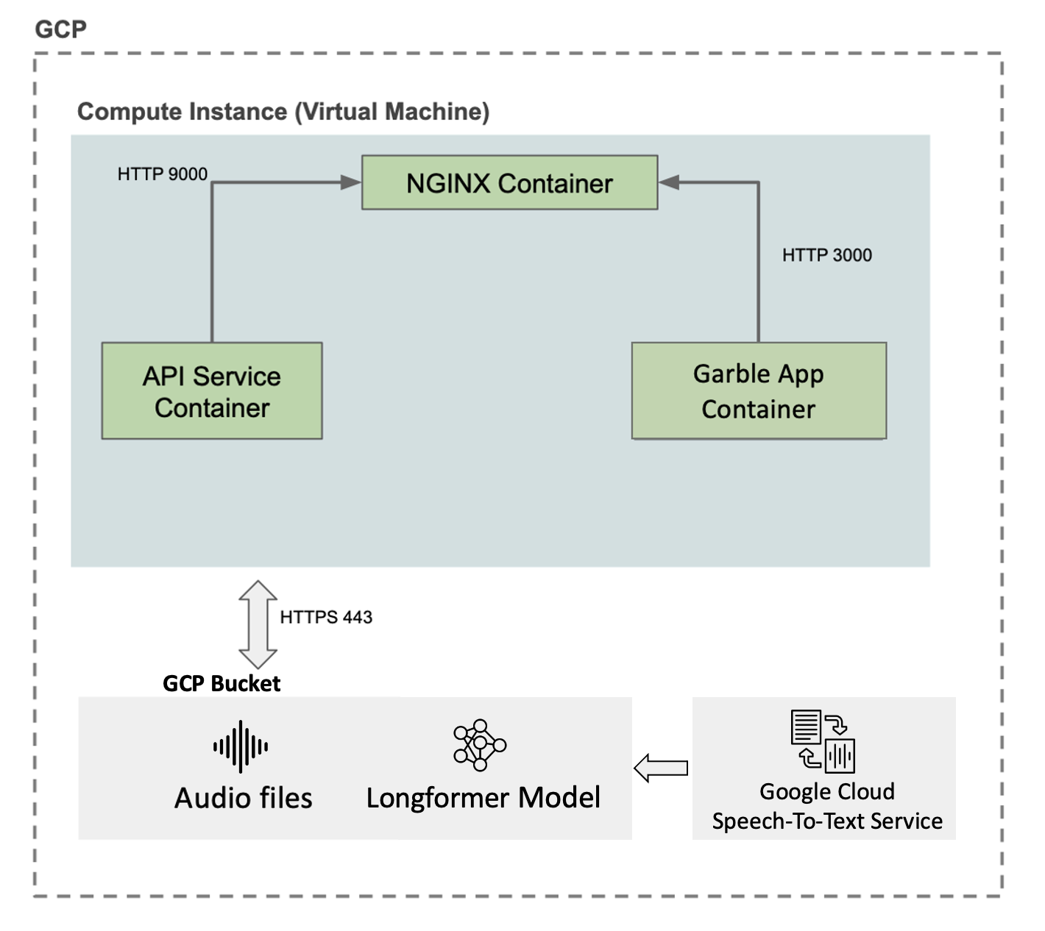
Architecture

Slide 6
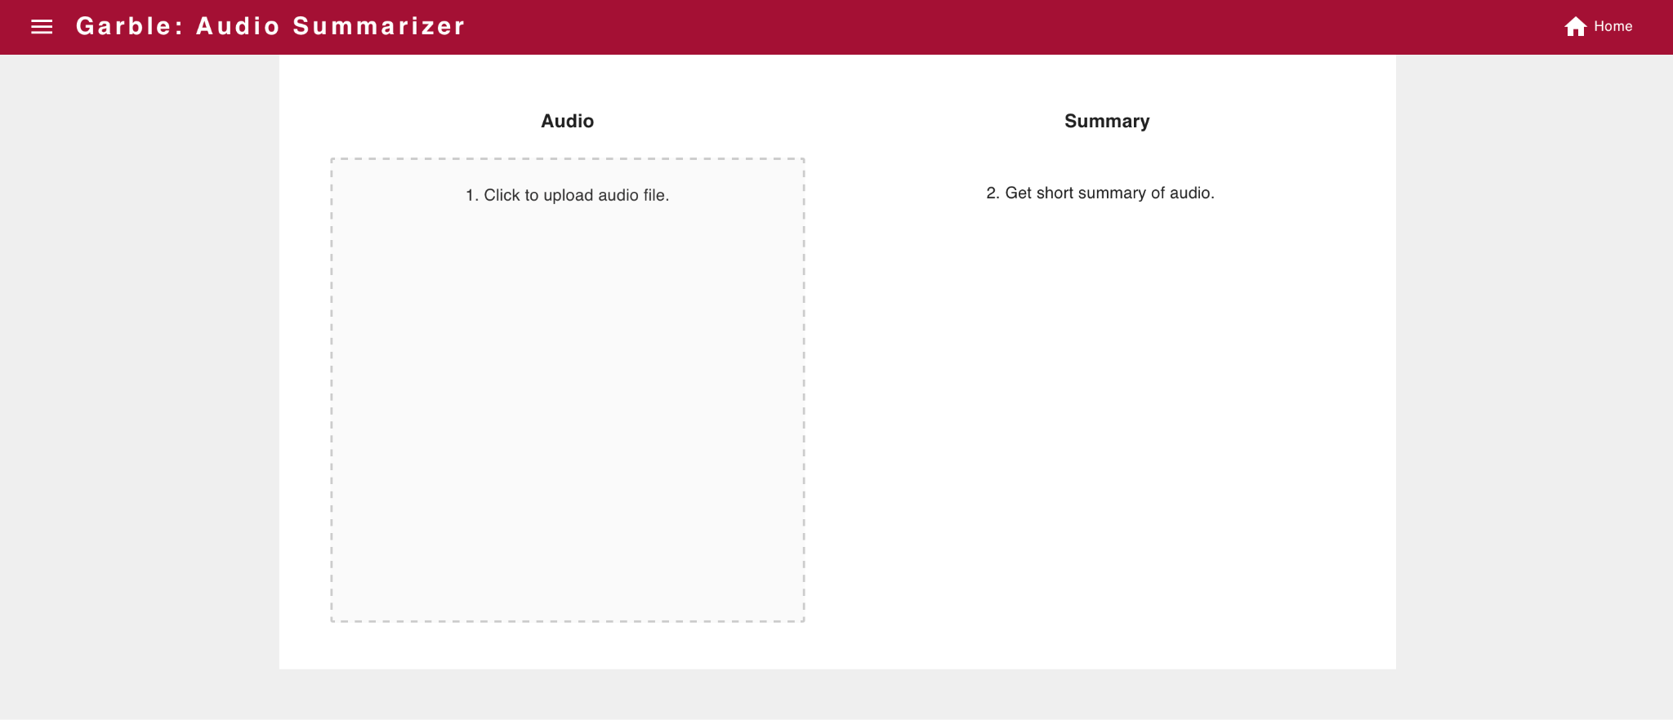
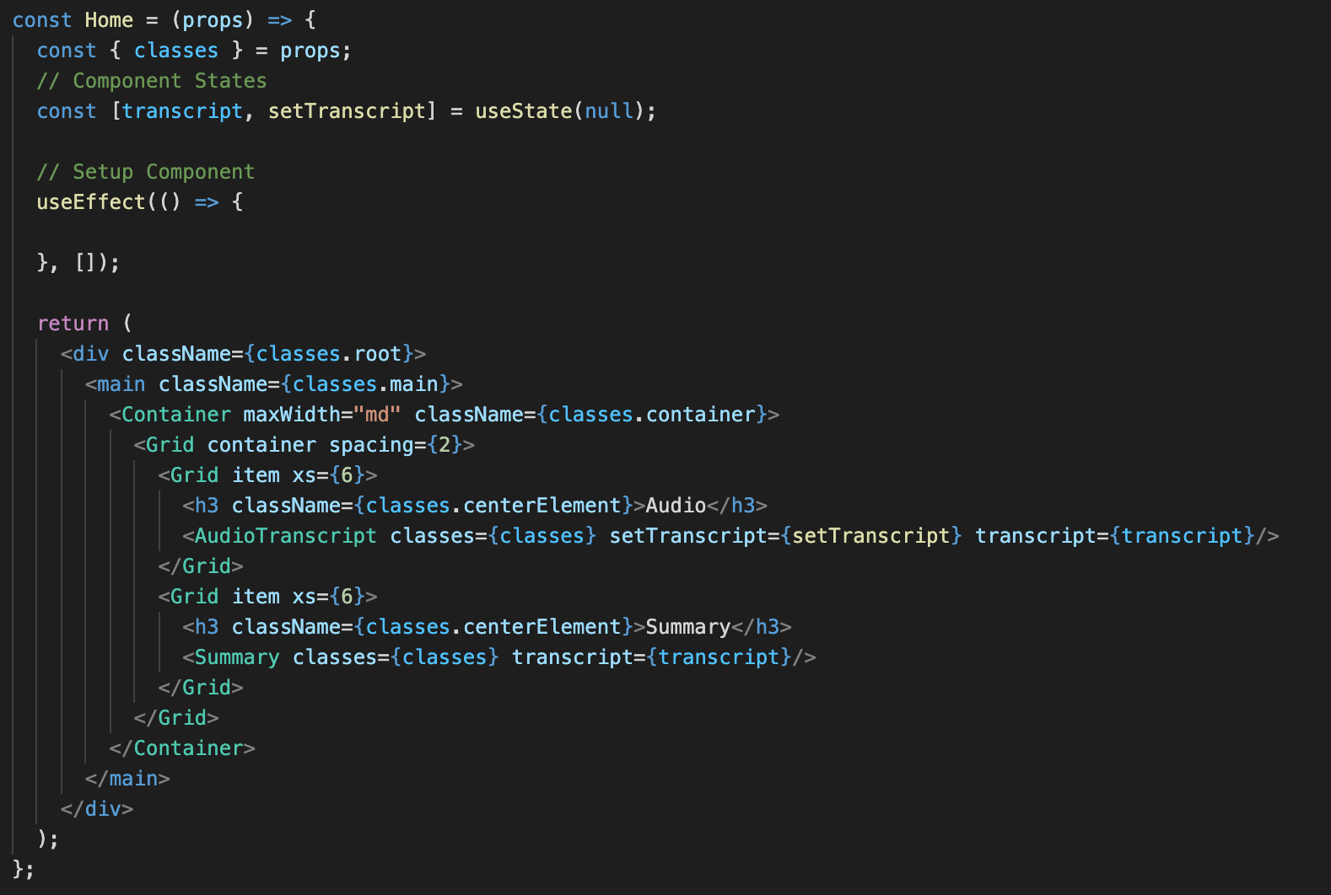
Frontend

Slide 7
Frontend

Slide 8
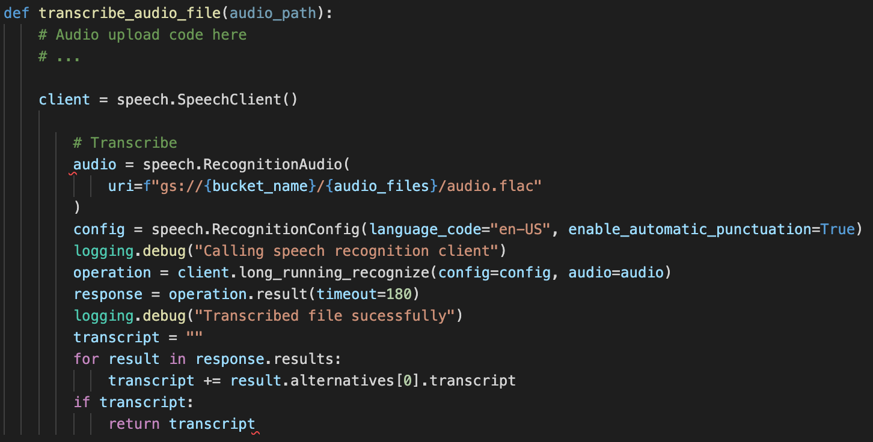
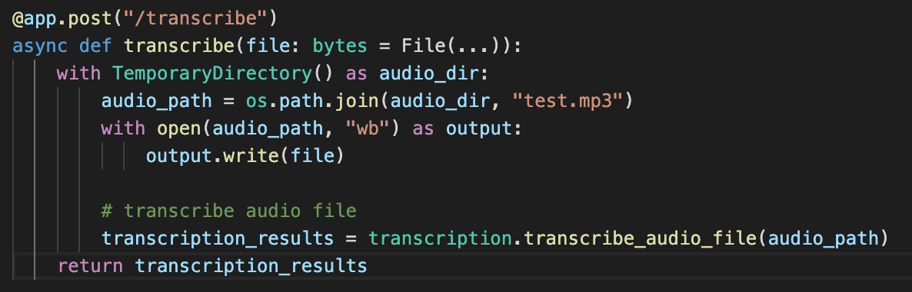
Backend: /transcribe

Slide 9
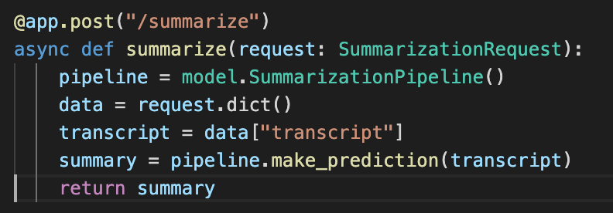
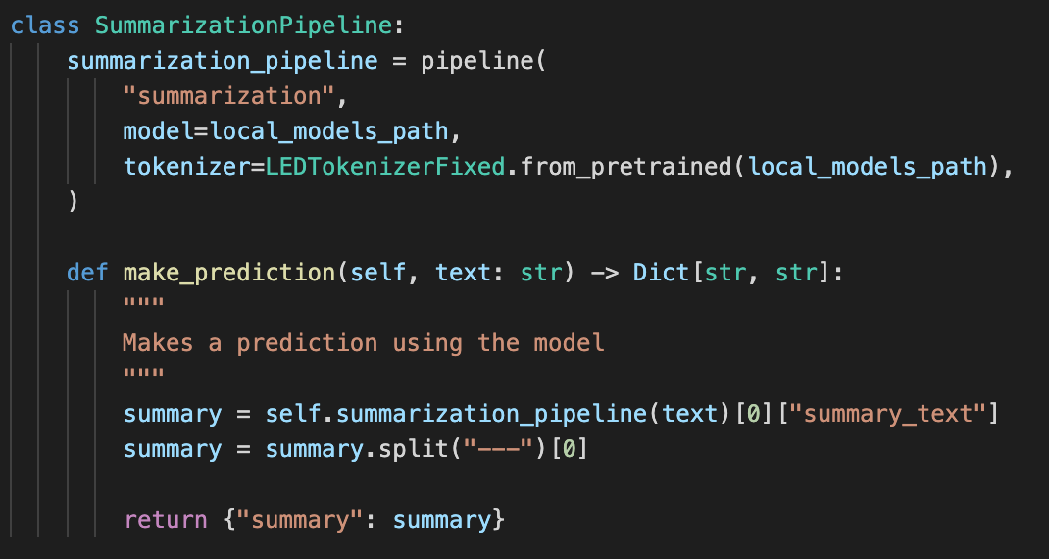
Backend: /summarize

Slide 10
Data Collection and Sources
We collect a corpus of spoken summarization datasets
We focus on abstractive summarization of podcasts and talk transcripts
A Multi-domain dataset
Transcripts
Interviews
Multi-party Meetings
News Broadcasts
News Articles
Name | Description | Train | Validation | Test
AMI | 100 hours of meeting transcripts | 95 | 29 | 13
ICSI | 70 hours of meeting transcripts | 41 | 12 | 6
MediaSum | 400K interview transcripts | 443597 | 10001 | 10001
Spotify | 100K podcast transcripts | 79173 | 9952 | 9940
TedX | 3K TED talk transcripts | 2828 | 606 | 606
CC News | 70K news articles | 566592 | 70824 | 70825
CNN/Dailymail | 300K news articles | 287113 | 13368 | 11490
X-Summ | 200K news articles | 204045 | 11332 | 11334
Total |  | 1583484 | 116124 | 114215
** for more details, check out the respective dataset_cards.md file for each dataset here: https://github.com/parambharat/AC215_projectgarble/tree/datasets/datasets/raw/supervised/summarization
Notes:
To train a deep learning model, we had to create a large enough dataset
to this end: We create an abstractive summarization corpus by combining existing available corpora.
We primarily focus on spoken document summaries
and collect document-summary pairs for podcasts, talks, meetings, and news broadcast along with news article summary pairs.
In total, we collect about 1.7 Million raw document-summary pairs.

Slide 11
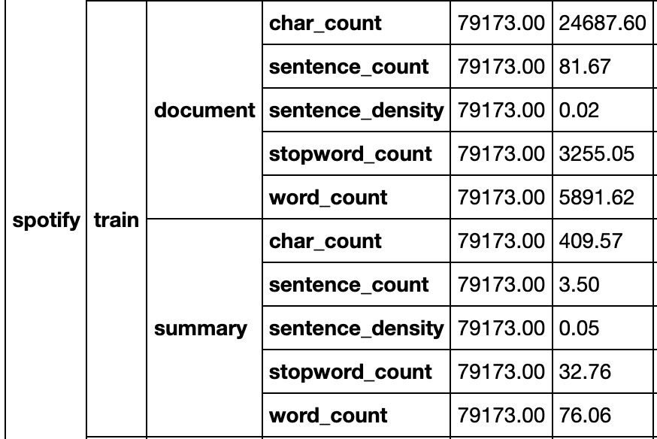
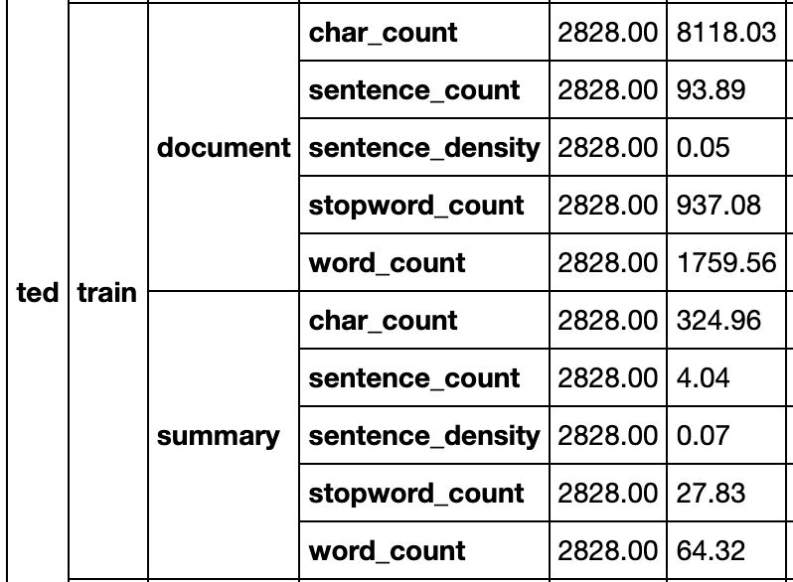
Data: Quality
Documents are usually longer and have lower information density than written text.
Transcript documents are quite long i.e. > 1024 tokens.
Summaries are mostly less than 500 tokens.
Talk descriptions are used as proxy for summary and are riddled with SEO keywords and links.
A mix of formatted and unformatted texts.
For more details: see https://github.com/parambharat/AC215_projectgarble/blob/datasets/notebooks/dataset_eda.ipynb
Notes:
Since the data is gathered from multiple sources we find a mix of punctuated, formatted and unformatted document-summary pairs in the corpus.
The spoken text corpora usually have longer documents and are generated using Automatic Speech Recognition Systems
These transcripts are prone to errors such as speech disfluencies and generally have low information density when compared to written text.
In some datasets like the TED talks and spotify dataset the talk descriptions are used as a proxy for the summary
These summaries are filled with noisy text such as urls, and search engine keywords
We address these and other issues in the dataset during the data clean up phase.

Slide 12
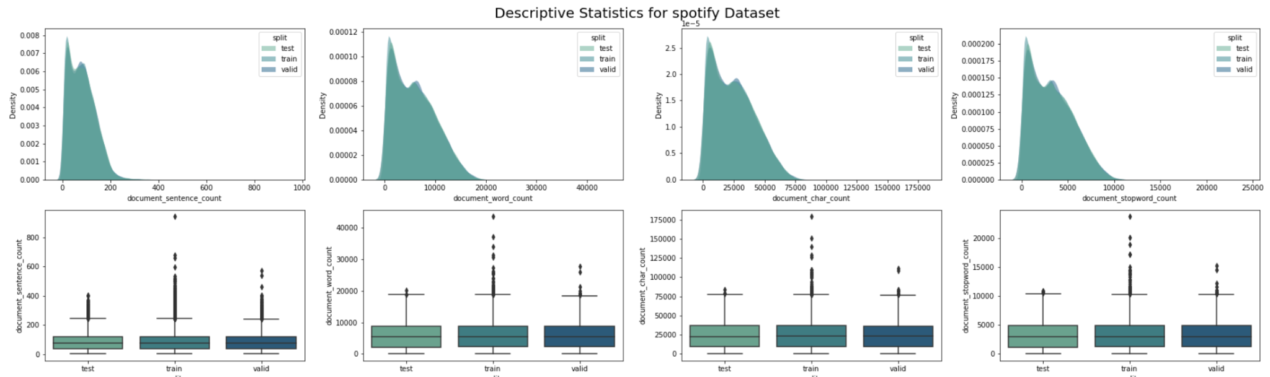
Exploratory Analysis
Descriptive Statistics for Spotify Dataset
We tokenize the documents into sentences and words using Spacy
Collect and visualize the following statistics:
Number of sentences
Number of words
Number of characters
Number words per sentence
Number of stopwords
Fraction of non stopwords
We clean up by:
retaining documents with word density greater than 10%.
retaining documents with 100 or more tokens.
truncating all documents greater than 16,000 tokens.
Notes:
During the exploratory stage we focus on gathering metrics that can help characterize the datasets for our task
We calculate relevant metrics such as the number of tokens per document and the ratio of words to stopwords in a document
We further visualize the distribution of the calculated descriptors and arrive at strategies for cleaning up the dataset
to clean up the data we first remove document that have less than 10% word density i.e. less than 10% of the words are not stopwords.
Next we remove small documents and retain document and summary pairs that have at least a 100 tokens.
finally we truncate all documents greater than 16000 tokens
We do not perform any additional text preprocessing such as lowercasing and punctuation removal since we want the model to generate human readable summaries.

Slide 13
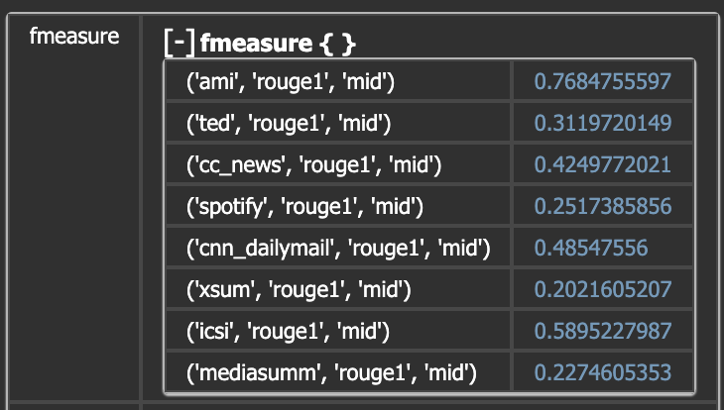
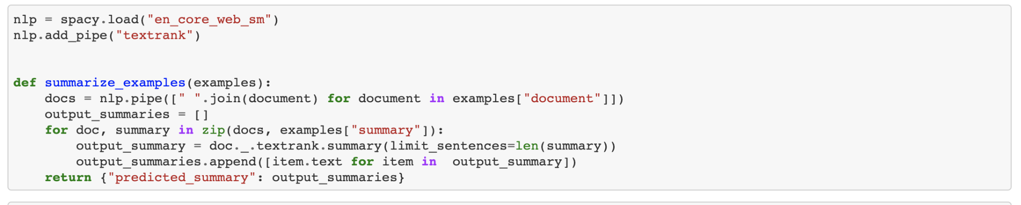
Baseline Model
For our initial baseline we use an off-the-shelf Textrank model from Spacy
This creates extractive summaries
We compare and report the rouge metrics
Model does poorly on talks where documents are long and summaries are short
Notes:
For our baseline we use the text rank algorithm to generate extractive summaries of the documents
We leverage an off the shelf implementation in spacy to generate the summaries
Then we compute the rouge metric of the model on each dataset
The model performs well when extracting long document summaries.
However, we observe that the performance degrades for shorter summaries.

Slide 14
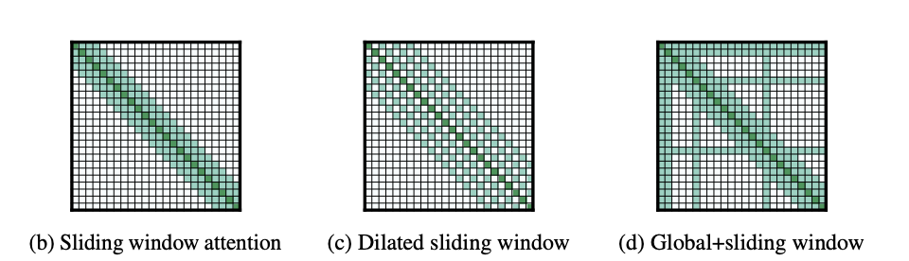
Model
We use the Longformer Encoder Decoder (LED) Model for summarization task.
It is well suited for long text summarization, can handle up to 16k tokens.
It reduce the operational complexity of attention mechanism from O(n^2) to O(n)
The model follows BART’s exact architecture in terms of number of layers and hidden sizes
Introduces the following sparse attention mechanisms
source: Longformer: The Long-Document Transformer, Iz Beltagy and Matthew E. Peters and Arman Cohan
Notes:
for the main abstractive summarization, we use the Longformer Encoder Decoder model
It is a specialized variant of the transformer architecture specifically built to handle long range language modelling tasks.
The key idea in the implementation is to reduce the memory complexity of the attention mechanism by introducing several novel sparse attention mechanism
These improvements reduces the space and memory requirements of the attention mechanism from n-squared to n
this make it feasible to train a model on very large sequences.

Slide 15
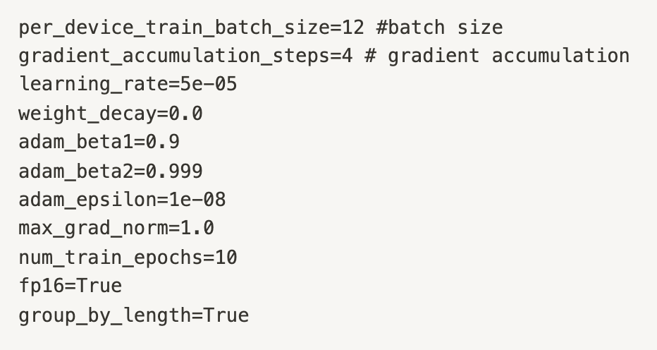
Training
We store the pre-processed data in apache arrow format using huggingface datasets for fast training.
We finetune “allenai/longformer-base-4096” model from huggingface hub.
We train for 6 epochs and it takes 20 hours/epoch to finetune the model on a single Nvidia v100 GPU.
We monitor the loss and rouge metrics after each epoch
We log a sample summary after each epoch for QA
Dataset | Train | Validation | Test
Count | 1109977 | 84955 | 83197
Size(GB) | 22 | 1.7 | 1.6
Dataset Size after Cleanup
Model Training Parameters
Notes:
To train the model we use the huggingface library
We finetune the pre-trained language model on the summarization task.
We train on a single GPU machine on Google Cloud Compute
We fine-tune both the encoder and the decoder weights
and train with a batch size of 12 with dynamically padded input and use a very low learning rate.
Each epoch takes about 20hours on a Nvidia V100 GPU
We train for a total of 6 epochs and measure the model performance on the validation set after each epoch.
We also generate a sample summary after each epoch to visualize the performance of the model during training.

Slide 16
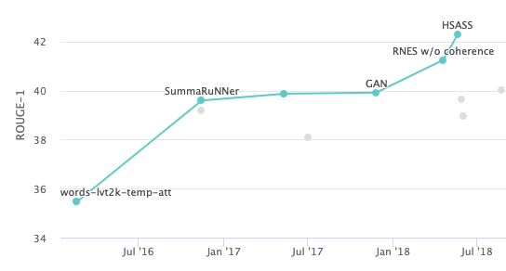
Results
We measure rouge scores and report the F1 values on the train, validation and test sets.
ROUGE stands for Recall-Oriented Understudy for Gisting Evaluation.
Works by comparing an automatically produced summary against a set of reference summaries
Rouge1 represents the percentage of unigrams that overlap between the generated and referenced summaries.
Rouge2 represent the percentage of bigrams that overlap between the generated and referenced summaries.
dataset | loss | rouge1 | rouge2 | rougeL | rougeLsum
train | 2.19 | 38.10 | 13.86 | 22.11 | 35.50
valid | 2.45 | 36.50 | 12.35 | 20.64 | 33.80
test | 2.40 | 37.25 | 14.13 | 22.67 | 34.48
SOTA Text Summarization on CNN / DailyMail
Notes:
For our results, we measure the Rouge score of the model on the training, validation and test sets
Rouge is a common metric used for evaluation of summarization and machine translation tasks.
It measures the percentage of overlapped tokens between a generated and reference summary.
Our model performs comparably to state-of-the-art models with a test rouge1 score of 37.25

Slide 17
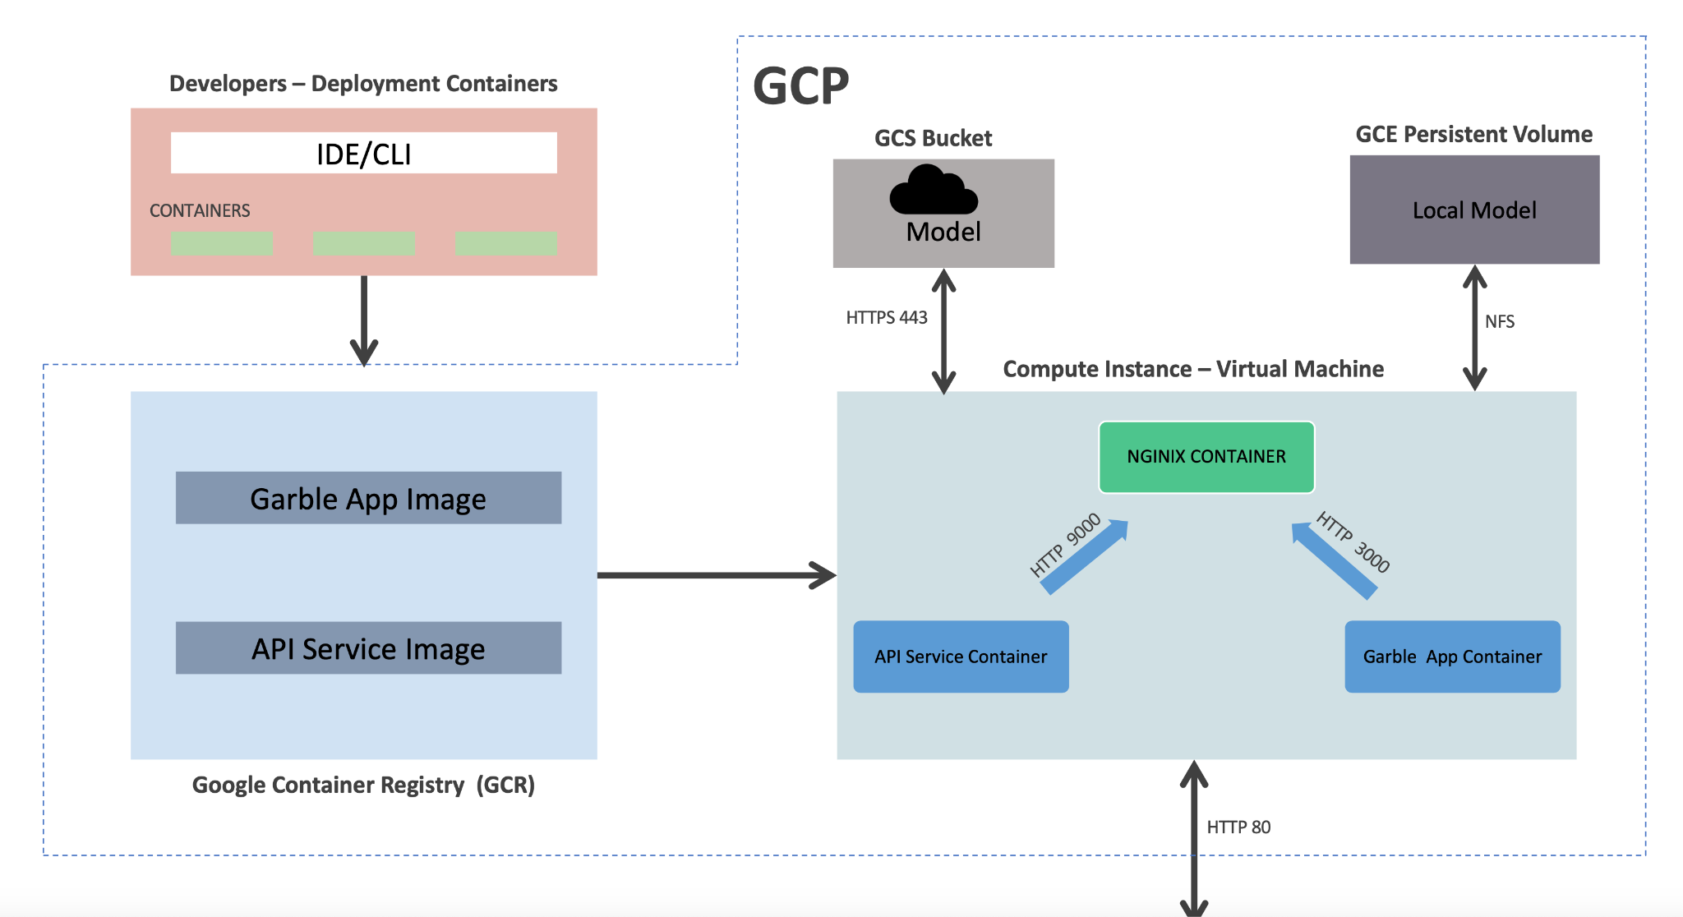
Deployment
GCP Service Accounts
Enable
Service Usage API
Cloud Resource Manager API
Google Container Registry API
Kubernetes Engine API
Cloud Speech-to-Text API
Computer Engine API

Slide 18
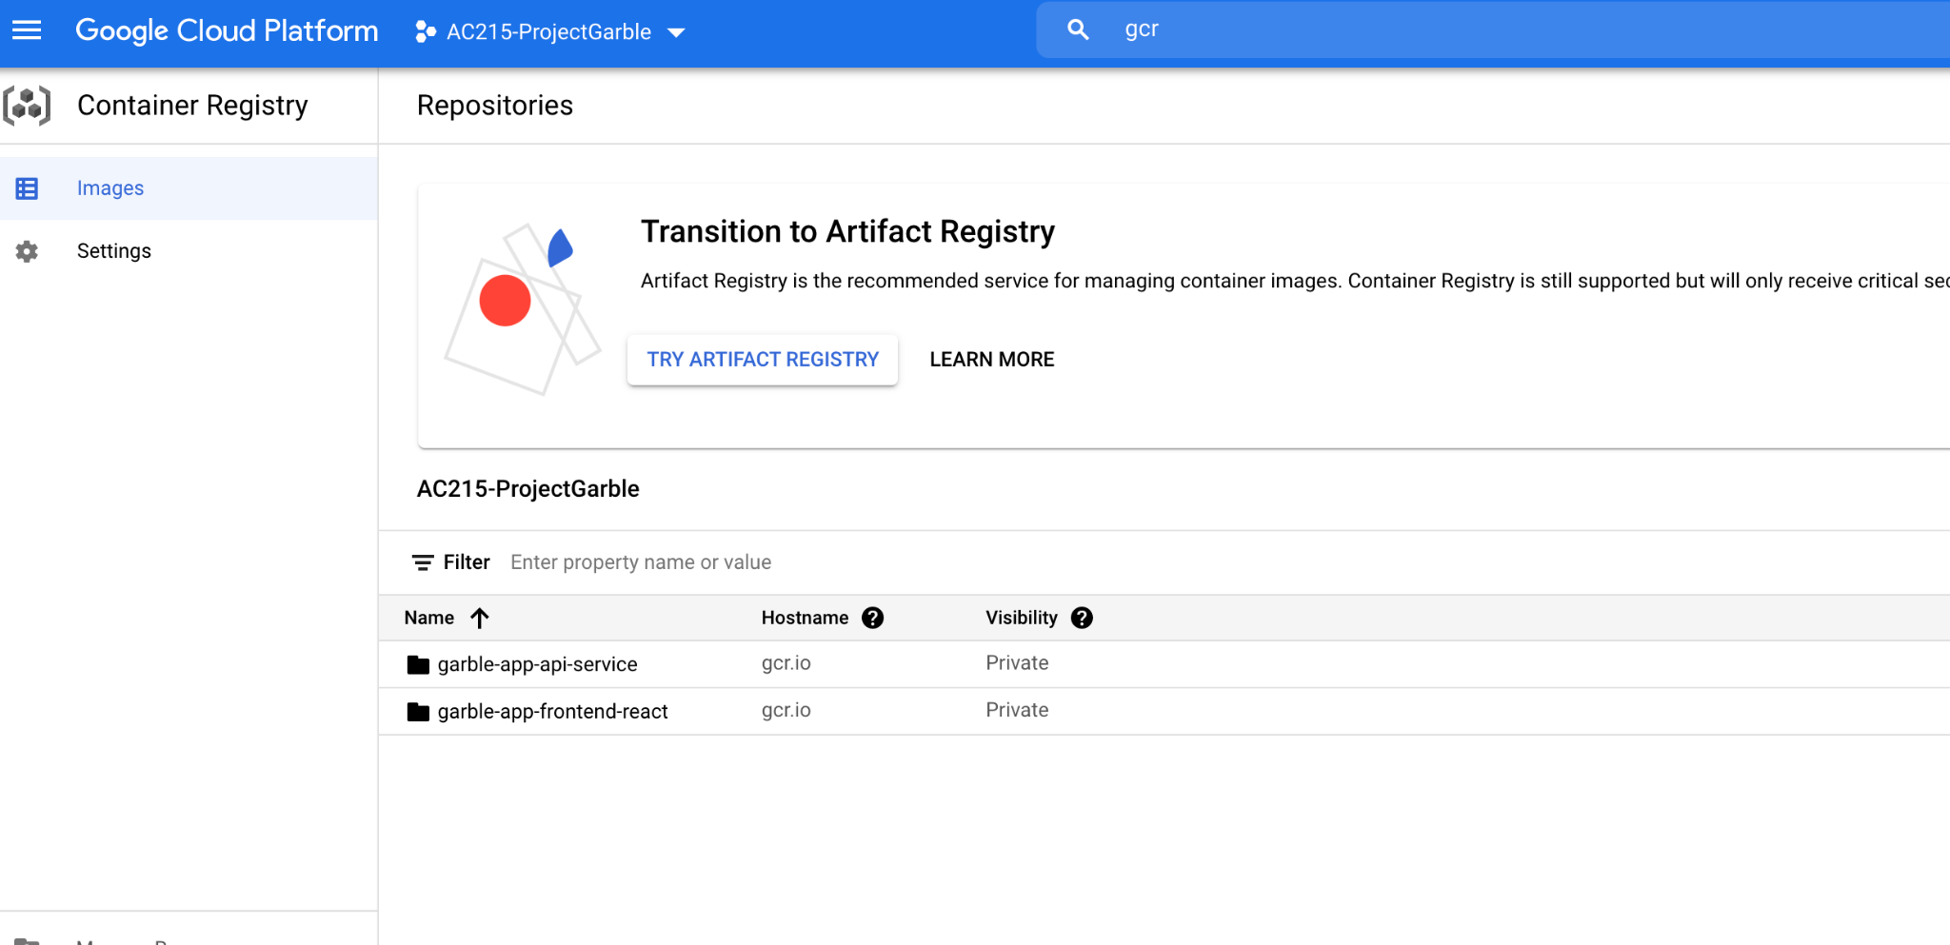
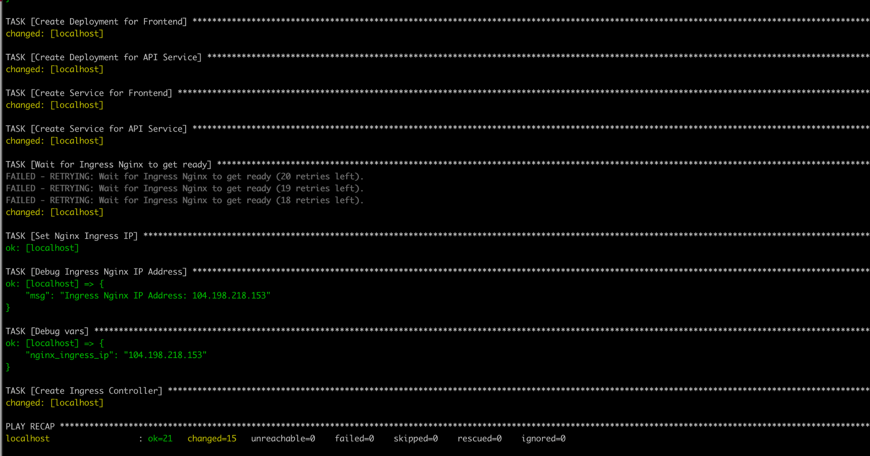
Deployment Cont...
Kubernetes Cluster
Velocity
Abstracting the infrastructure
Efficiency
Scaling

Slide 19


Future Work/Improvement
Improve the UI/UX
Improve the summarization
Improve the architecture

Slide 20


Slide 21
Outline
Problem Definition (.5 min)
The Solution (2.5 min)
Architecture (1 min)
Frontend & Backend (1 min)
Data & Model - AI (2 min)
Deployment (1.5 min)
Future Work/Improvement (.5min)

